Slide 1
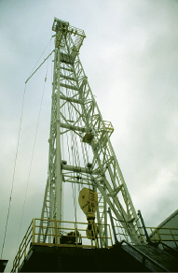
ABSOLUTE DEPENDENT MOTION ANALYSIS OF TWO PARTICLES
Today’s Objectives:
Students will be able to:
Relate the positions, velocities, and accelerations of particles undergoing dependent motion.
In-Class Activities:
• Check Homework
• Reading Quiz
• Applications
• Define Dependent Motion
• Develop Position, Velocity, and Acceleration Relationships
• Concept Quiz
• Group Problem Solving
• Attention Quiz

Slide 2
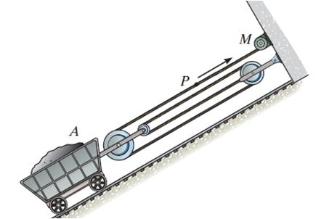
APPLICATIONS
The cable and pulley system shown can be used to modify the speed of the mine car, A, relative to the speed of the motor, M.
It is important to establish the relationships between the various motions in order to determine the power requirements for the motor and the tension in the cable.
For instance, if the speed of the cable (P) is known because we know the motor characteristics, how can we determine the speed of the mine car? Will the slope of the track have any impact on the answer?

Slide 3
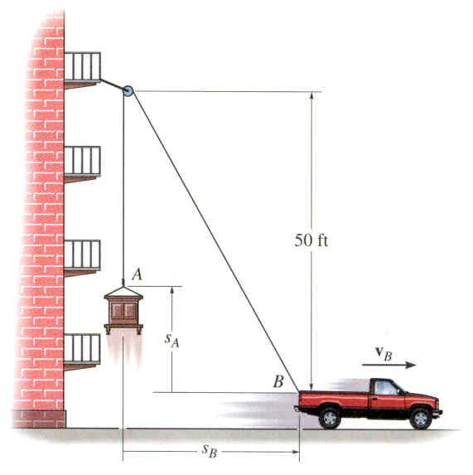
APPLICATIONS (continued)
Rope and pulley arrangements are often used to assist in lifting heavy objects. The total lifting force required from the truck depends on both the weight and the acceleration of the cabinet.
How can we determine the acceleration and velocity of the cabinet if the acceleration of the truck is known?

Slide 4
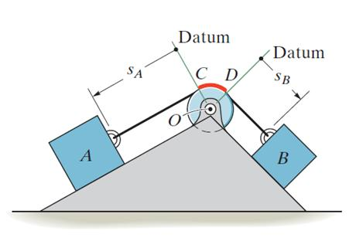
DEPENDENT MOTION (Section 12.9)
In many kinematics problems, the motion of one object will depend on the motion of another object.
The blocks in this figure are connected by an inextensible cord wrapped around a pulley. If block A moves downward along the inclined plane, block B will move up the other incline.
The motion of each block can be related mathematically by defining position coordinates, s_{A} and s_{B}. Each coordinate axis is defined from a fixed point or datum line, measured positive along each plane in the direction of motion of each block.

Slide 5
DEPENDENT MOTION (continued)
In this example, position coordinates s_{A} and s_{B} can be defined from fixed datum lines extending from the center of the pulley along each incline to blocks A and B.
If the cord has a fixed length, the position coordinates s_{A} and s_{B} are related mathematically by the equation
s_{A} + l_{CD} + s_{B} = l_{T}
Here l_{T} is the total cord length and l_{CD} is the length of cord passing over the arc CD on the pulley.

Slide 6
DEPENDENT MOTION (continued)
The velocities of blocks A and B can be related by differentiating the position equation. Note that l_{CD} and l_{T} remain constant, so dl_{CD}/dt = dl_{T}/dt = 0
ds_{A}/dt + ds_{B}/dt = 0 => v_{B} = -v_{A}
The negative sign indicates that as A moves down the incline (positive s_{A} direction), B moves up the incline (negative s_{B} direction).
Accelerations can be found by differentiating the velocity expression. Prove to yourself that a_{B} = -a_{A} .

Slide 7
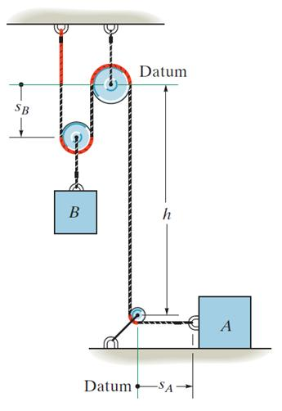
DEPENDENT MOTION EXAMPLE
Consider a more complicated example. Position coordinates (s_{A} and s_{B}) are defined from fixed datum lines, measured along the direction of motion of each block.
Note that s_{B} is only defined to the center of the pulley above block B, since this block moves with the pulley. Also, h is a constant.
The red colored segments of the cord remain constant in length during motion of the blocks.

Slide 8
DEPENDENT MOTION EXAMPLE (continued)
The position coordinates are related by the equation
2s_{B} + h + s_{A} = l_{T}
Where l_{T} is the total cord length minus the lengths of the red segments.
Since l_{T} and h remain constant during the motion, the velocities and accelerations can be related by two successive time derivatives:
2v_{B} = -v_{A} and 2a_{B} = -a_{A}
When block B moves downward (+s_{B}), block A moves to the left (-s_{A}). Remember to be consistent with your sign convention!

Slide 9
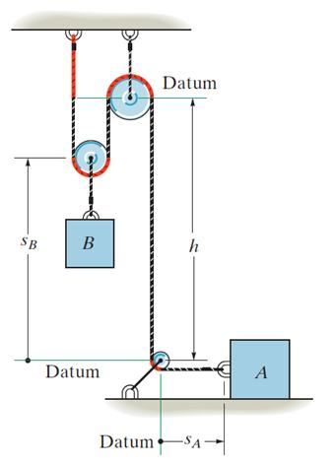
DEPENDENT MOTION EXAMPLE (continued)
This example can also be worked by defining the position coordinate for B (s_{B}) from the bottom pulley instead of the top pulley.
The position, velocity, and acceleration relations then become
2(h – s_{B}) + h + s_{A} = l_{T}
and 2v_{B} = v_{A} 2a_{B} = a_{A}
Prove to yourself that the results are the same, even if the sign conventions are different than the previous formulation.

Slide 10
DEPENDENT MOTION: PROCEDURES
These procedures can be used to relate the dependent motion of particles moving along rectilinear paths (only the magnitudes of velocity and acceleration change, not their line of direction).
1. Define position coordinates from fixed datum lines, along the path of each particle. Different datum lines can be used for each particle.
2. Relate the position coordinates to the cord length. Segments of cord that do not change in length during the motion may be left out.
3. If a system contains more than one cord, relate the position of a point on one cord to a point on another cord. Separate equations are written for each cord.
4. Differentiate the position coordinate equation(s) to relate velocities and accelerations. Keep track of signs!

Slide 11
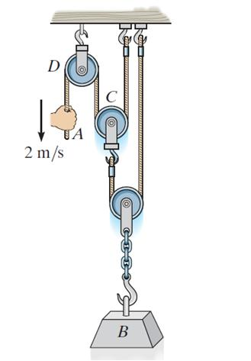
EXAMPLE
Given: In the figure on the left, the cord at A is pulled down with a speed of 2 m/s.
Find: The speed of block B.
Plan:
There are two cords involved in the motion in this example. There will be two position equations (one for each cord). Write these two equations, combine them, and then differentiate them.

Slide 12
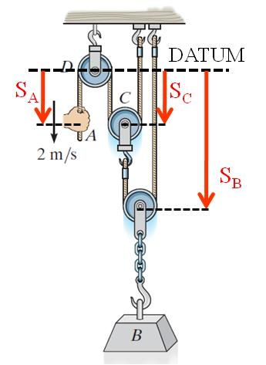
EXAMPLE (continued)
Solution:
1) Define the position coordinates from a fixed datum line. Three coordinates must be defined: one for point A (s_{A}), one for block B (s_{B}), and one for block C (s_{C}).
• Define the datum line through the top pulley (which has a fixed position).
• s_{A} can be defined to the point A.
• s_{B} can be defined to the center of the pulley above B.
• s_{C} is defined to the center of pulley C.
• All coordinates are defined as positive down and along the direction of motion of each point/object.

Slide 13

EXAMPLE (continued)
2) Write position/length equations for each cord. Define l₁ as the length of the first cord, minus any segments of constant length. Define l₂ in a similar manner for the second cord:
Cord 1: s_{A} + 2s_{C} = l₁
Cord 2: s_{B} + (s_{B} – s_{C}) = l₂
3) Eliminating s_{C} between the two equations, we get
s_{A} + 4s_{B} = l₁ + 2l₂
4) Relate velocities by differentiating this expression. Note that l₁ and l₂ are constant lengths.
v_{A} + 4v_{B} = 0 => v_{B} = – 0.25v_{A} = – 0.25(2) = – 0.5 m/s
The velocity of block B is 0.5 m/s up (negative s_{B} direction).

Slide 14
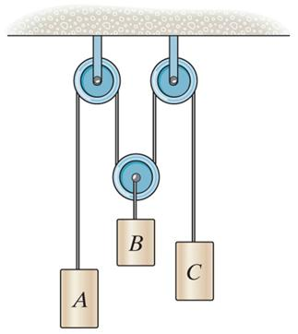
GROUP PROBLEM SOLVING
Given: In this pulley system, block A is moving downward with a speed of 4 ft/s while block C is moving up at 2 ft/s.
Find: The speed of block B.
Plan:
All blocks are connected to a single cable, so only one position/length equation will be required. Define position coordinates for each block, write out the position relation, and then differentiate it to relate the velocities.

Slide 15
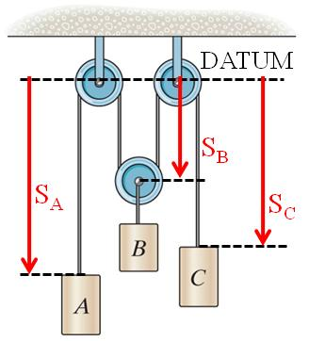
GROUP PROBLEM SOLVING (continued)
Solution:
1) A datum line can be drawn through the upper, fixed, pulleys and position coordinates defined from this line to each block (or the pulley above the block).
2) Defining s_{A}, s_{B}, and s_{C} as shown, the position relation can be written:
s_{A} + 2s_{B} + s_{C} = l
3) Differentiate to relate velocities:
v_{A} + 2v_{B} + v_{C} = 0
4 + 2v_{B} + (-2) =0
v_{B} = -1 ft/s
The velocity of block B is 1 ft/s up (negative s_{B} direction).

Slide 16
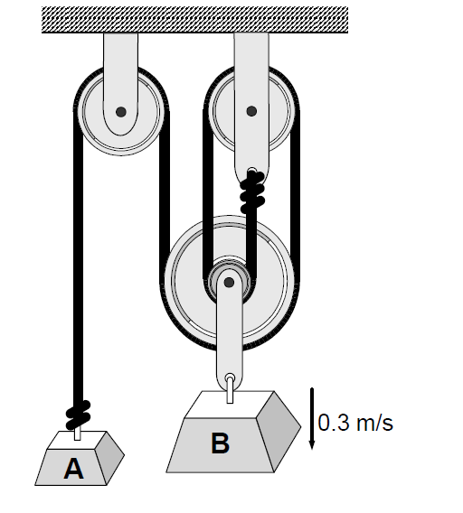
At what rate, and in which direction must weight A move if weight B is to fall at a rate of 0.3 m/s?

Slide 17
